Slide 1
3DEXPERIENCE Platform
Widget Development
2019.06.18
VS Korea VSCC
sci1@3ds.com

Slide 2


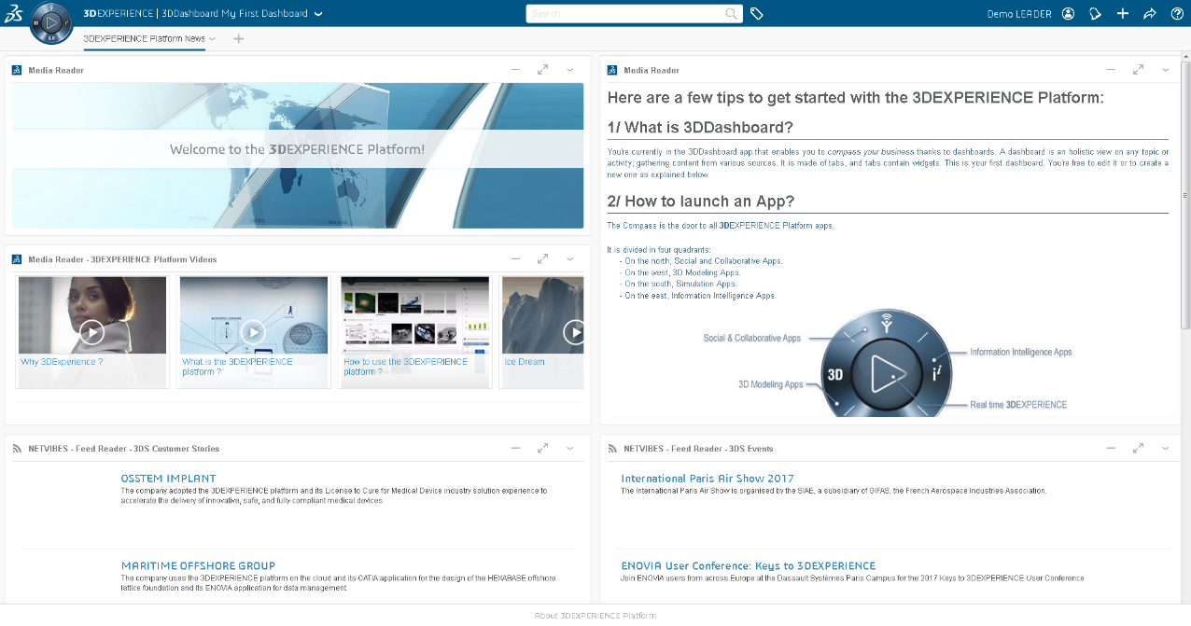
From This Session,
X
O

Slide 3
Agenda
Widget Overview
Widget Architecture
Widget Capabilities
Widget Development
Widget Debugging
Widget Reference

Slide 4
Widget Overview

Slide 5

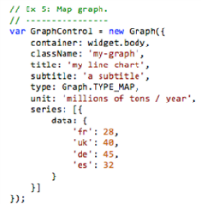
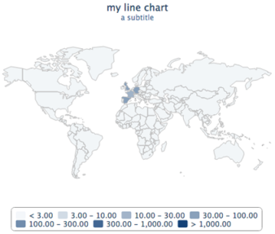
Prerequisites
Before working with this, user should be familar with Languages HTML and CSS. User should have a basic knowledge of and understanding of ENOVIA Customizing, WebService and some experience with JavaScript Language.
ENOVIA 개발 경력 3년 이상 추천
Java / JPO
REST Web Services
JavaScript & UWA
HTML5
CSS
Object Oriented JavaScript
(OOJS)

Slide 6
Why do we need Widget?
usages of widget
Access management
Licensing, rigths, Access, Roles
Data management
Share views, models, tabs etc
CRUD (Create, Read, Update, Delete), navigation (queries) anywhere anyplace
Automation
To avoid human error and provide an up-to-date data
Metrics generation

Slide 7
Why do we need Widget?
usages of widget
Collaboration
Chat service
Real time sharing
Subscription mechanisms
UI Visualization & 3D (This is available from 3DEXPERIENCER 2016x)
Being able to modify models Rendering textures, shades, etc
Monitoring
To assess situation in a global picture
Live monitoring to have trends on quality metrics for everyone

Slide 8
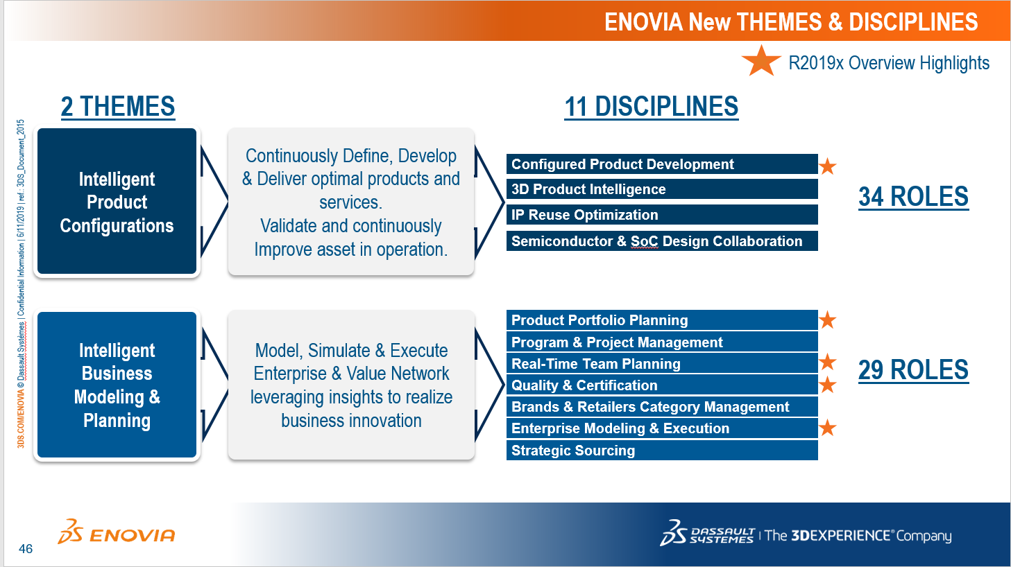
Why do we need Widget?
Advantage
- Easy
- Productivity
- Deploy
- Upgrade
- JavaScript Open Source
- Single Code (CV5, CV6, Platform)
Disadvantage
- OOTB Widget Customize
- No Rule
usages of widget
ENOVIA에서 3DDashboard 이동 중

Slide 9
Widget Architecture

Slide 10
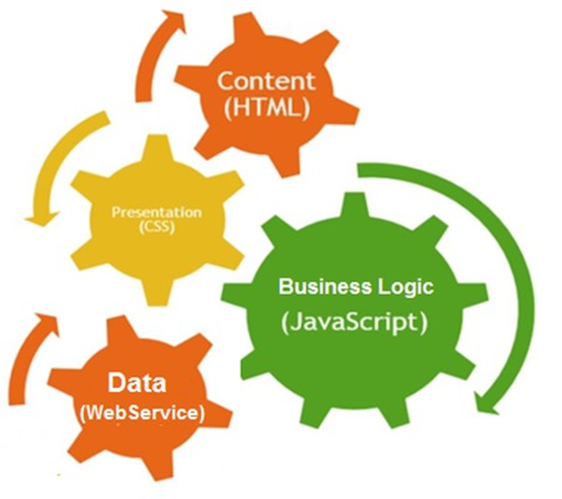
Widget Architecture Components
The Widget is HTML file compliant with UWA Protocol (Universal Web App) with:
Should be compliant with IFWE Compass User Experience fundamentals
Business logic written in JavaScript
StyleSheet made in CSS
Use of WebService to access data.

Slide 11
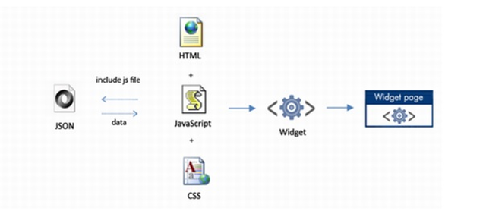


Widget Architecture Components
Data: The data model defines the resources.
HTML/CSS: The presentation consists in widgets enabling the end-user to control/manage the resources
JavaScript: The business logic guarantees the resource integrity
WebService : The web services gives an access to the resources (data model or business logic).
3DEXPERIENCE Platform
Client Web Browser
RESTful WS
jar

Slide 12
Widget Capabilities

Slide 13
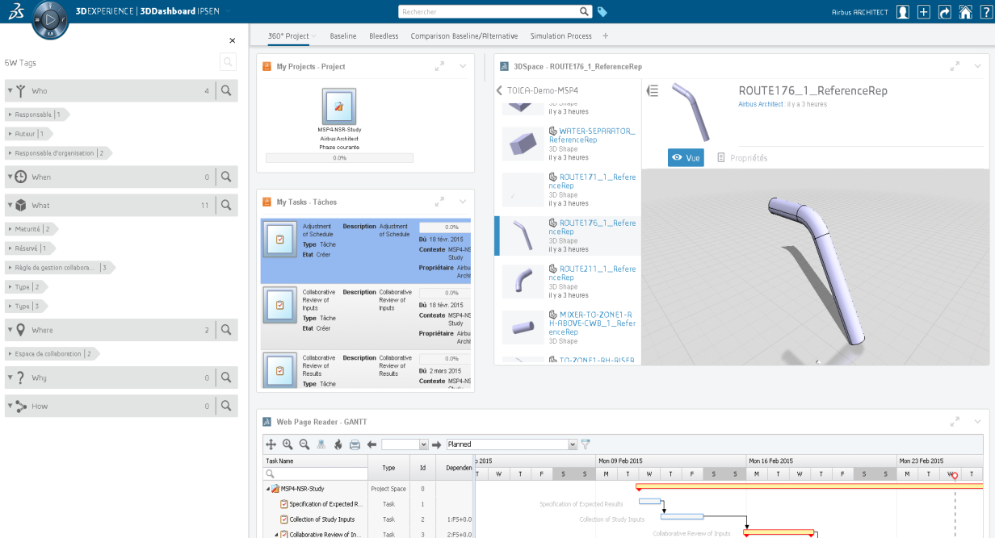
Technical Information Widget Capabilities
Some WEB Services
With :
Others widgets
3D Compass
3D Search
6W Tagger
Top Bar
WEB Services
My Widget

Slide 14
Widget Development

Slide 15

Deactivate 3DDashboard Cache
On your server go to :
Windows : C:\3ds\3ddashboard\webapps\3ddashboard\WEB-INF\classes\
Modify the file :
context.properties
Change :
uwp.cache.type = ehcache → uwp.cache.type = nocache

Slide 16
Require and Define
AMD design pattern
(Asynchronous Module Definition)
Require and Define are 2 js functions
Require is used to load and use some JS Modules (APIs)
Define is used to declare a new JS Module
The return of the define function callback will be an object representing the module with all it’s function
Example :
require([], function(){ … }); //Require nothing
require([“DS/LibA/ModuleB”, “DS/LibC/ModuleA”], function(modB, modA){ … }); //Require ModuleB from LibA/LibA.js and ModuleA from LibC/LibC.js
define(“DS/NewModule/ModuleA”, [“DS/LibA/ModuleB”, “DS/LibC/ModuleA”], function(modB, modA){
var moduleCustom = { … };
return moduleCustom; //moduleCustom will be the object returned when using the module “DS/NewModule/ModuleA”
});

Slide 17
Some Definitions
CORS:
Cross-Origin Resource Sharing
Mechanism to allow the exchange of data between pages of different domains.
Read about it : https://developer.mozilla.org/en-US/docs/Web/HTTP/CORS
JSONP :
JavaScript Object Notation with Padding
Format that can be used to exchange data Cross-Domain
JSON
JSONP
{ “key” : “value”,
“key” : [“val1”,“val2”] }
callback_padding_str(
{ “key” : “value”,
“key” : [“val1”,“val2”] }
);
Format of data returned :

Slide 18
1 - First widget « Hello World »

Slide 19
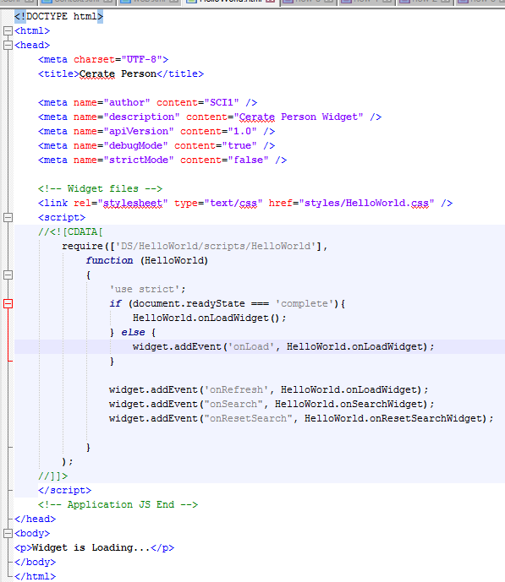
First widget « Hello World »
On your server go to :
C:\R2019x\3DSpace\win_b64\code\tomee\webapps\3dspace\webapps\
Step 1 : Add your own folder
Example : HelloWorld
Step 2 : Add the “Hello World” Widget
Example : HelloWorld.html
Step 3 : Update the “HelloWorld.html”
Copy & Paste
<!DOCTYPE html>
<html>
<head>
<meta charset="UTF-8">
<title>Cerate Person</title>
<meta name="author" content="SCI1" />
<meta name="description" content="Cerate Person Widget" />
<meta name="apiVersion" content="1.0" />
<meta name="debugMode" content="true" />
<meta name="strictMode" content="false" />
<!-- Widget files -->
<link rel="stylesheet" type="text/css" href="styles/HelloWorld.css" />
<script>
//<![CDATA[
require(['DS/HelloWorld/scripts/HelloWorld'],
function (HelloWorld)
{
'use strict';
if (document.readyState === 'complete'){
HelloWorld.onLoadWidget();
} else {
widget.addEvent('onLoad', HelloWorld.onLoadWidget);
}
widget.addEvent('onRefresh', HelloWorld.onLoadWidget);
widget.addEvent("onSearch", HelloWorld.onSearchWidget);
widget.addEvent("onResetSearch", HelloWorld.onResetSearchWidget);
}
);
//]]>
</script>
<!-- Application JS End -->
</head>
<body>
<p>Widget is Loading...</p>
</body>
</html>
Step 3

Slide 20
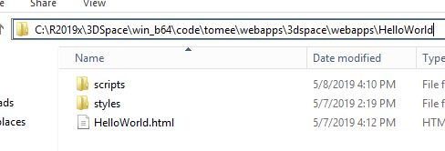
First widget « Hello World »
On your server go to :
C:\R2019x\3DSpace\win_b64\code\tomee\webapps\3dspace\webapps\HelloWorld
Step 4: Add your sub folder
Example : scripts
Step 5 : Add your sub folder
Example : styles

Slide 21
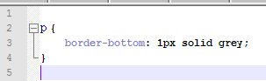
First widget « Hello World »
On your server go to :
C:\R2019x\3DSpace\win_b64\code\tomee\webapps\3dspace\webapps\HelloWorld\styles
Step 6 : Add the “Hello World” CSS
Example : HelloWorld.css
Step 7 : Update the “HelloWorld.css”
Copy & Paste
Step 7
p {
border-bottom: 1px solid grey;
}

Slide 22
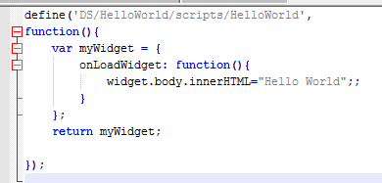
First widget « Hello World »
On your server go to :
C:\R2019x\3DSpace\win_b64\code\tomee\webapps\3dspace\webapps\HelloWorld\scripts
Step 8 : Add the “Hello World” JavaScript
Example : HelloWorld.js
Step 9 : Update the “HelloWorld.js”
Copy & Paste
define('DS/HelloWorld/scripts/HelloWorld',
function(){
var myWidget = {
onLoadWidget: function(){
widget.body.innerHTML="Hello World";;
}
};
return myWidget;
});
Step 9

Slide 23
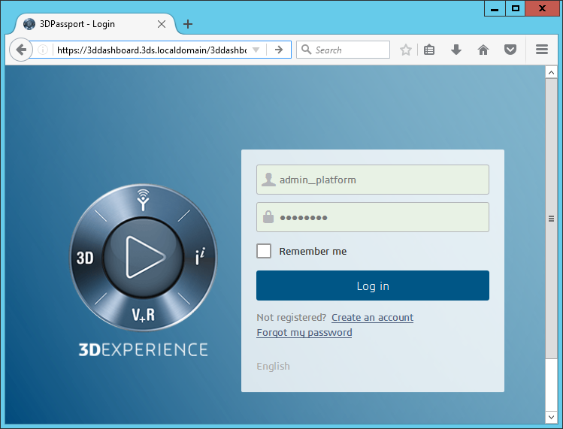
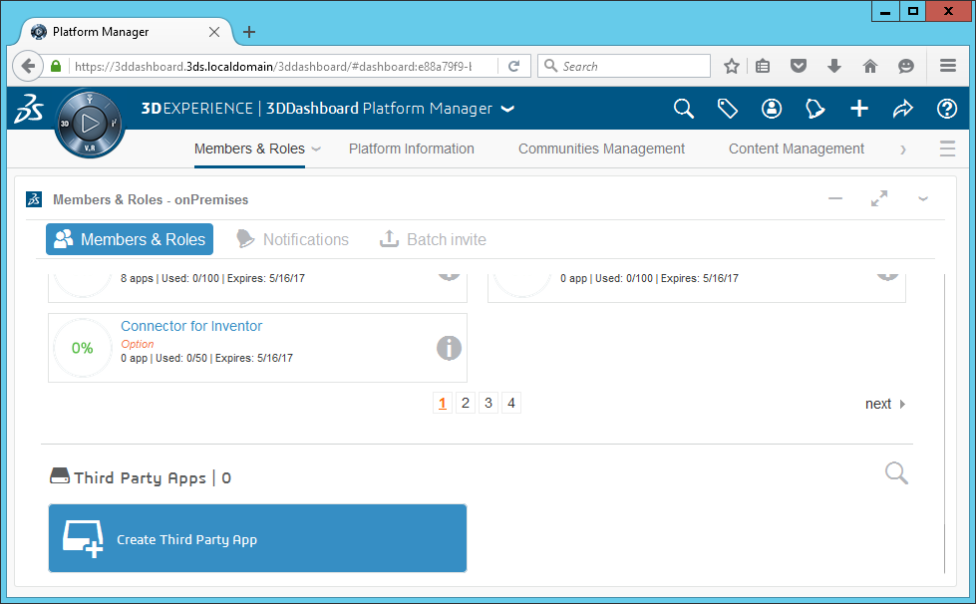
First widget « Hello World »
Add widget to 3DEXPERIENCE Platform
Login to 3DDashboard as a admin
Change dashboard to “Platform Manager”
Click “Create Third Party App” in the “Members & Roles” Tap
Step 11
Step 10
Step 12
If you have loading trouble,
click refresh button in widget menu
Step 13

Slide 24
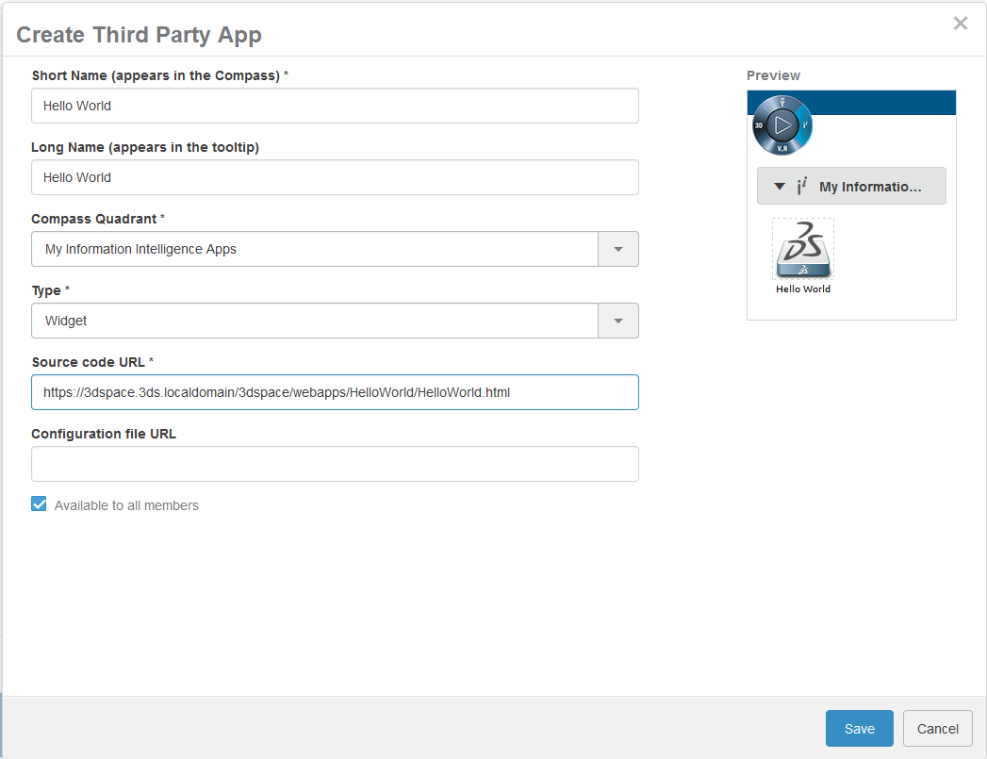
First widget « Hello World »
Add widget to 3DEXPERIENCE Platform
Widget’s Name
Select Widget’s Location in 3DCompass
Select Widget
Drag & Drop Icon (option)
Input Widget file’s location
https://3dspace.3ds.localdomain/3dspace/webapps/HelloWorld/HelloWorld.html
Step 14

Slide 25
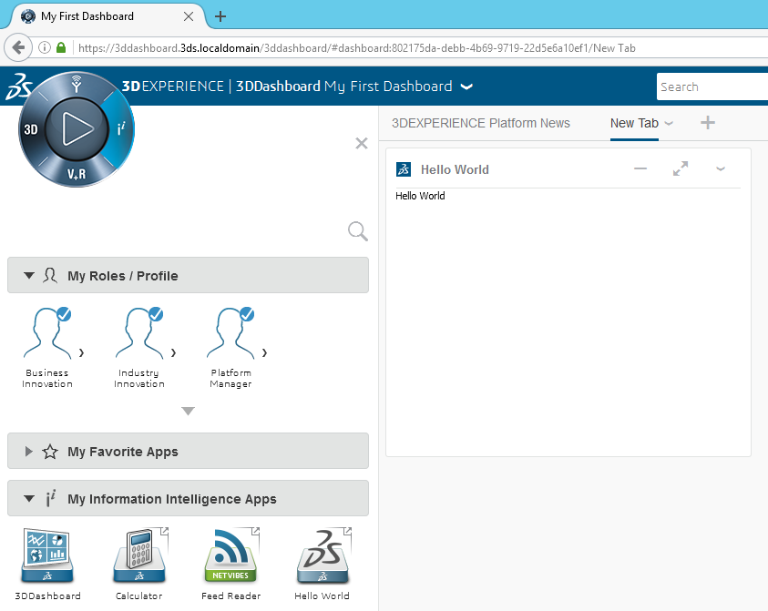
First widget « Hello World »
Instantiate a widget in a tab of a 3D Dashboard
Add New Dashboard
Drag & Drop
Step 15
Step 16

Slide 26
2 - Working with WEB Services
Get Project Information

Slide 27
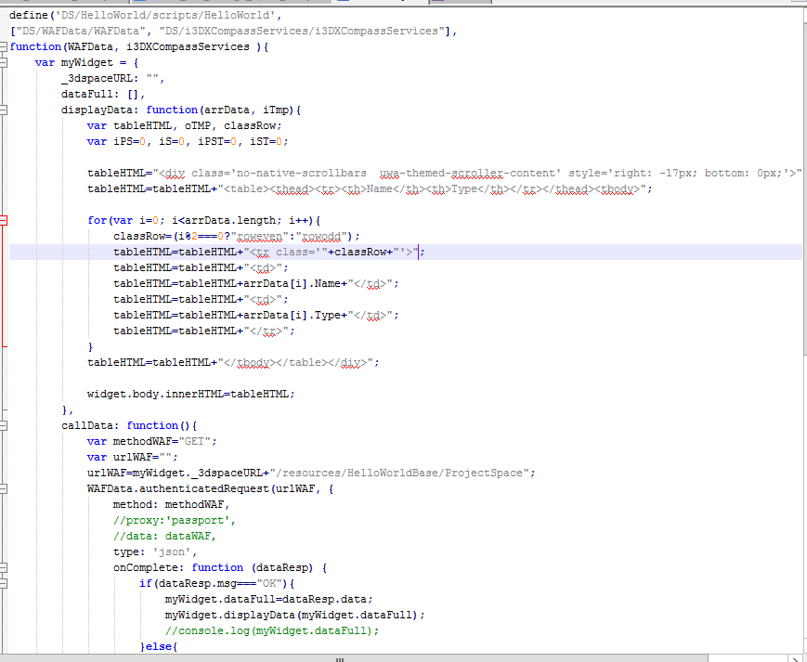
HelloWorld.js
편의상 파일 이름은 변경하지 않음
Copy & Paste
define('DS/HelloWorld/scripts/HelloWorld',
["DS/WAFData/WAFData", "DS/i3DXCompassServices/i3DXCompassServices"],
function(WAFData, i3DXCompassServices ){
var myWidget = {
_3dspaceURL: "",
dataFull: [],
displayData: function(arrData, iTmp){
var tableHTML, oTMP, classRow;
var iPS=0, iS=0, iPST=0, iST=0;
tableHTML="<div class='no-native-scrollbars uwa-themed-scroller-content' style='right: -17px; bottom: 0px;'>";
tableHTML=tableHTML+"<table><thead><tr><th>Name</th><th>Type</th></tr></thead><tbody>";
for(var i=0; i<arrData.length; i++){
classRow=(i%2===0?"roweven":"rowodd");
tableHTML=tableHTML+"<tr class='"+classRow+"'>";
tableHTML=tableHTML+"<td>";
tableHTML=tableHTML+arrData[i].Name+"</td>";
tableHTML=tableHTML+"<td>";
tableHTML=tableHTML+arrData[i].Type+"</td>";
tableHTML=tableHTML+"</tr>";
}
tableHTML=tableHTML+"</tbody></table></div>";
widget.body.innerHTML=tableHTML;
},
callData: function(){
var methodWAF="GET";
var urlWAF="";
urlWAF=myWidget._3dspaceURL+"/resources/HelloWorldBase/ProjectSpace";
WAFData.authenticatedRequest(urlWAF, {
method: methodWAF,
//proxy:'passport',
//data: dataWAF,
type: 'json',
onComplete: function (dataResp) {
if(dataResp.msg==="OK"){
myWidget.dataFull=dataResp.data;
myWidget.displayData(myWidget.dataFull);
//console.log(myWidget.dataFull);
}else{
widget.body.innerHTML += "<p>Error in WebService Response</p>";
widget.body.innerHTML += "<p>"+JSON.stringify(dataResp)+"</p>";
}
},
onFailure: function(error){
widget.body.innerHTML += "<p>Call Faillure</p>";
widget.body.innerHTML += "<p>"+JSON.stringify(error)+"</p>";
}
});
},
get3DSpaceURL: function(callback){
i3DXCompassServices.getServiceUrl({
serviceName: '3DSpace',
platformId: widget.getValue('x3dPlatformId'),
onComplete : function(datafromCompass){
if (typeof datafromCompass === "string"){
myWidget._3dspaceURL=datafromCompass;
callback();
}
},
onFailure: function(){
alert("Impossible to retrieve 3DSpace Service URL");
}
});
},
onLoadWidget: function(){
myWidget.get3DSpaceURL(myWidget.callData);
}
};
return myWidget;
});

Slide 28
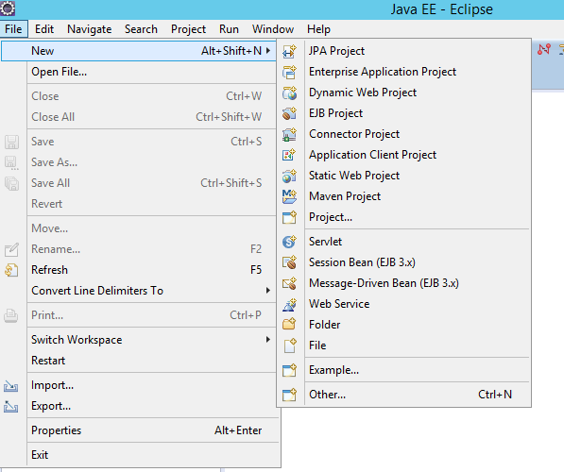
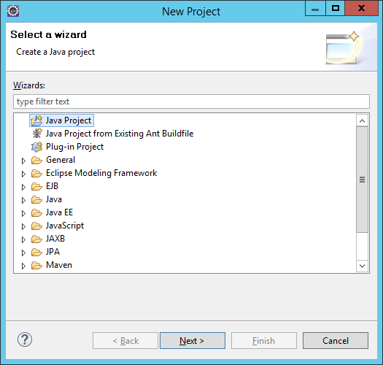
Set Develop Environment
Java project 생성
2
1
3

Slide 29
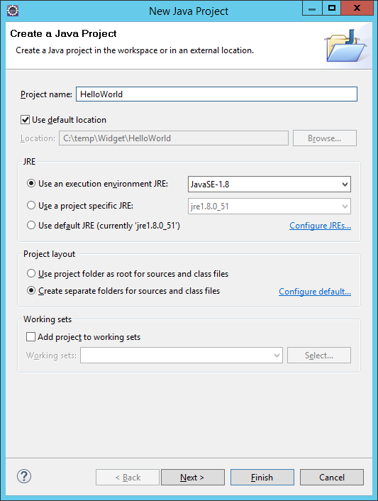
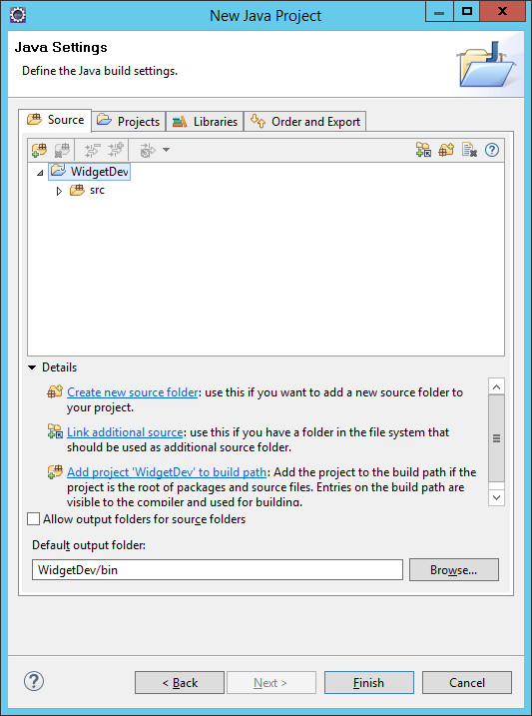
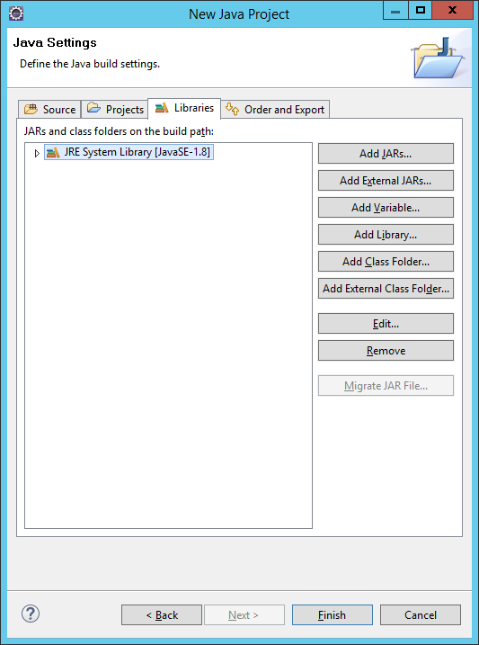
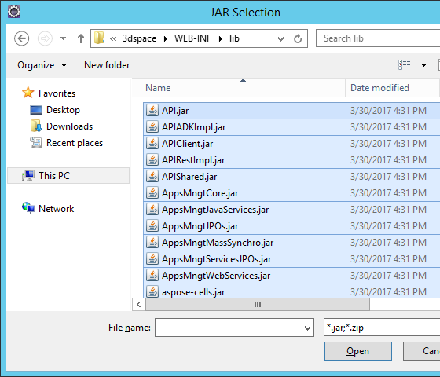
Set Develop Environment
Project 이름 : HelloWorld
아래 폴더의 모든 jar 파일 로딩
C:\R2019x\3DSpace\win_b64\code\tomee\webapps\3dspace\WEB-INF\lib
C:\R2019x\3DSpace\win_b64\code\tomee\lib
1
3
4
5
6
Select All
7
2

Slide 30
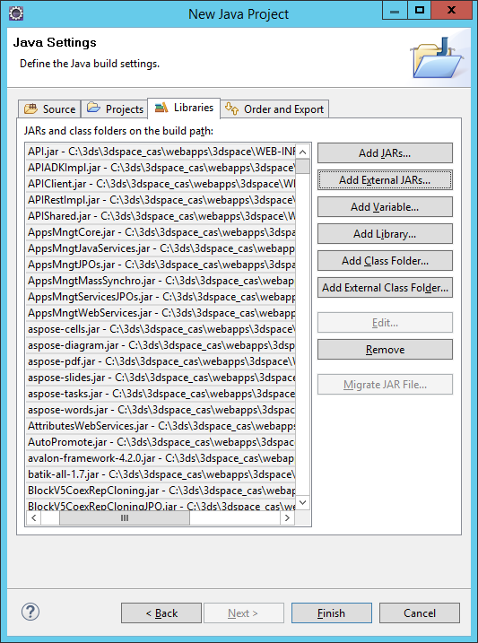
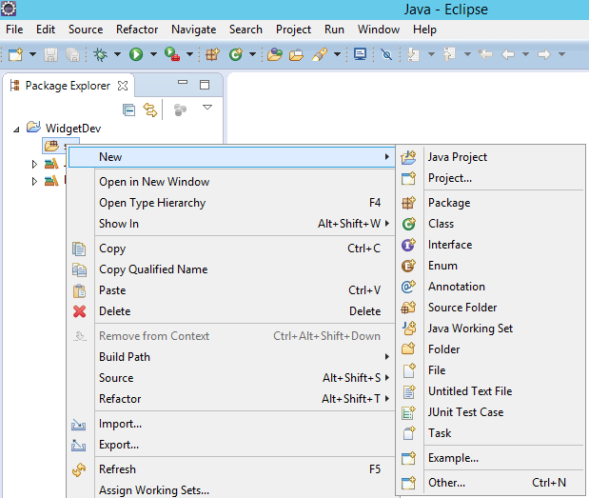
Set Develop Environment
Package 생성
2
1

Slide 31
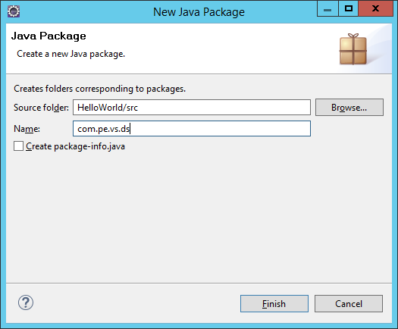
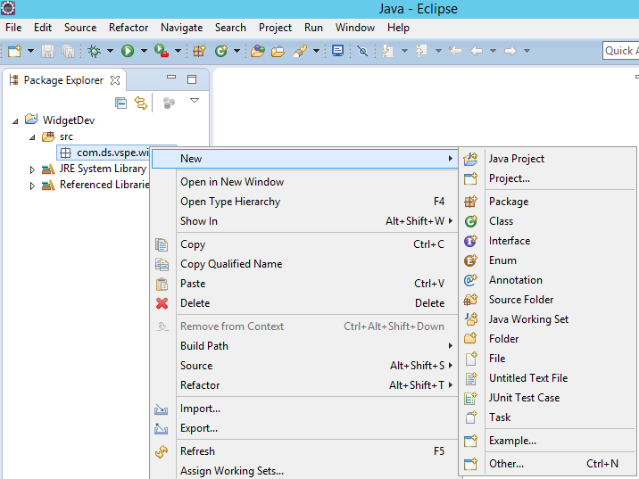
Set Develop Environment
src 선택
Class 생성
3
1
com.pe.vs.ds
4
2

Slide 32
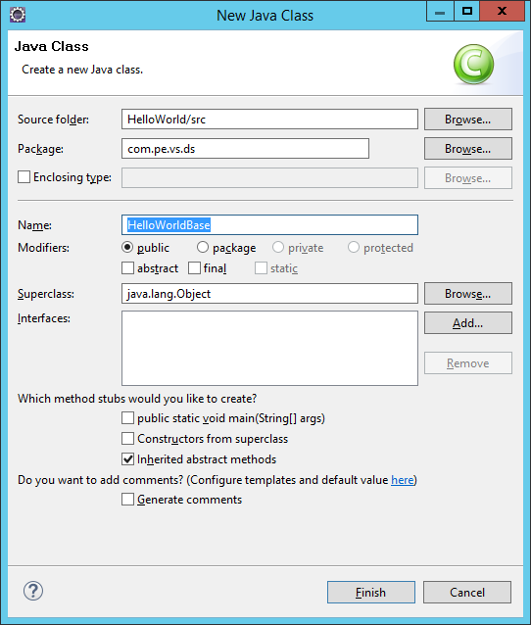
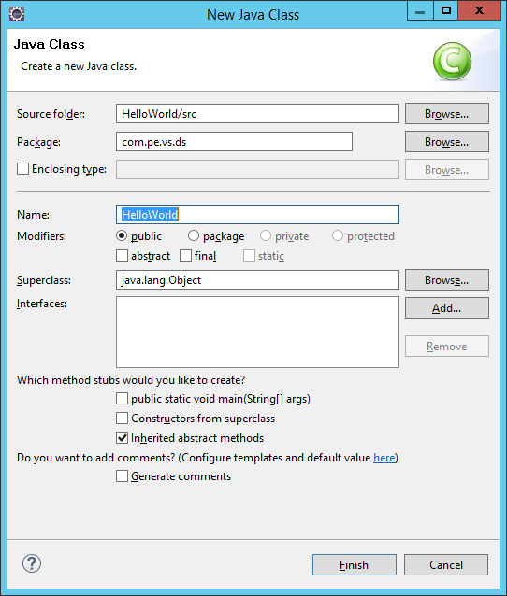
Set Develop Environment
HelloWorldBase Class 생성
ProjectSpace Class 생성
1
3
ProjectSpace
2
4

Slide 33
HelloWorldBase.java
HelloWorldBase.java extends ModelerBase
package com.pe.vs.ds;
import javax.ws.rs.*;
import com.dassault_systemes.platform.restServices.ModelerBase;
@ApplicationPath(ModelerBase.REST_BASE_PATH + "/HelloWorldBase")
public class HelloWorldBase extends ModelerBase {
@Override
public Class<?>[] getServices() {
// TODO Auto-generated method stub
return new Class<?>[] {ProjectSpace.class};
}
}
Copy & Paste

Slide 34
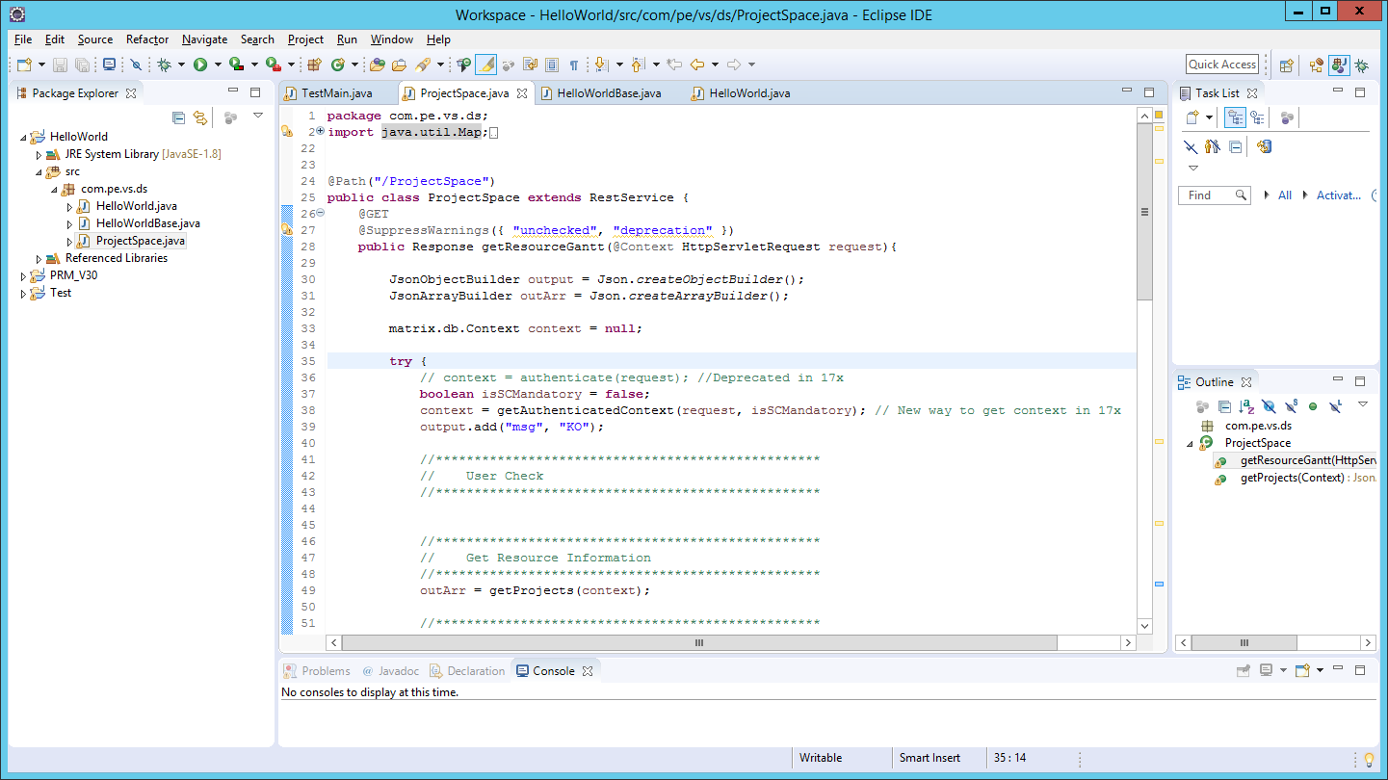
ProjectSpace.java
ProjectSpace.java extends RestServices
Copy & Paste

Slide 35
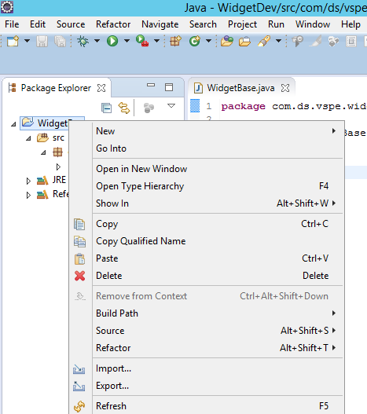
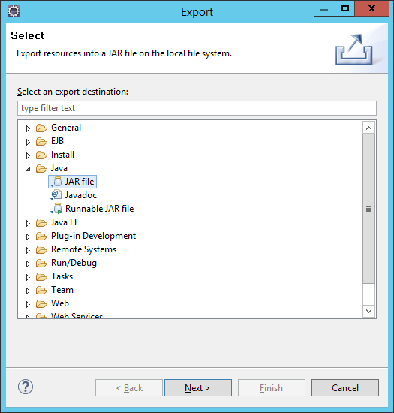
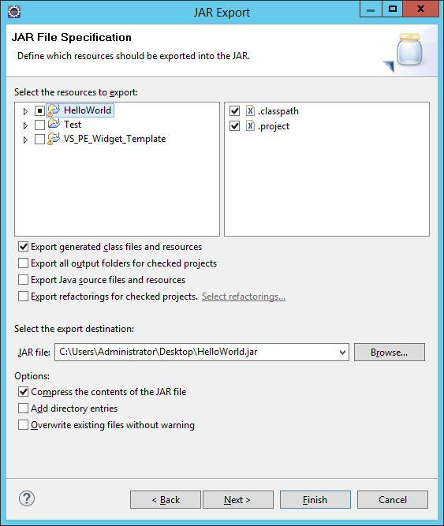
Deploy jar file
2
4
1
3
5
C:\Users\Administrator\Desktop\HelloWorld.jar

Slide 36
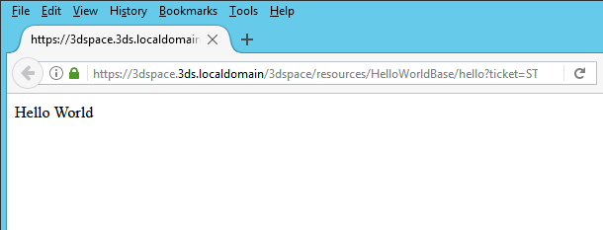
Deploy jar file
바탕화면에 HelloWorld.jar를 export
3dspace_cas Tomee Service Shutdown
해당 jar파일을 아래 폴더에 이동
C:\R2019x\3DSpace\win_b64\code\tomee\webapps\3dspace\WEB-INF\lib
3dspace_cas Tomee Startup
5. 결과 체크
1. Platform에 로그인
2. Web Browser에 아래 URL 입력
ex) https://3dspace.3ds.localdomain/3dspace/resources/HelloWorldBase/hello

Slide 37
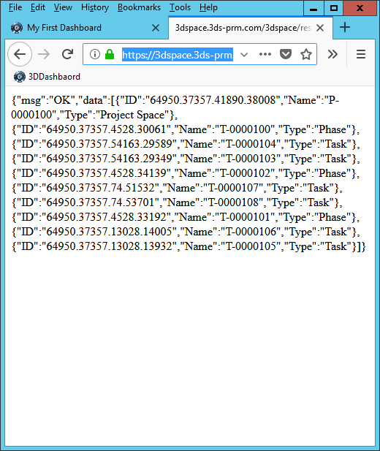
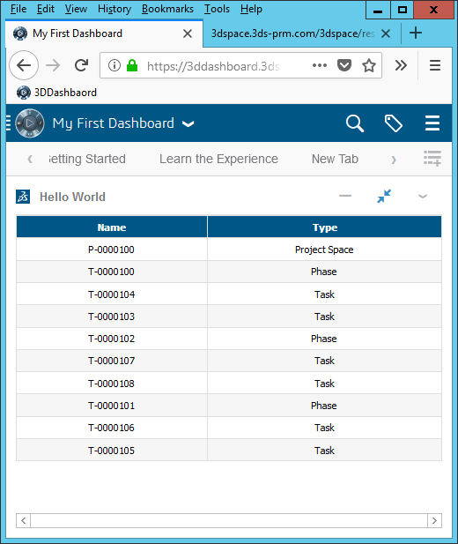
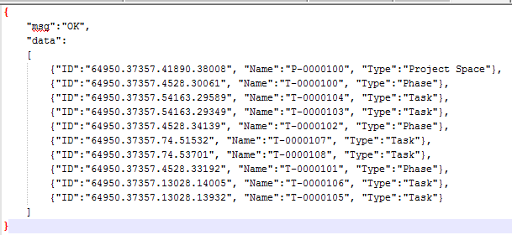
https://3dspace.3ds.localdomain/3dspace/resources/HelloWorldBase/ProjectSpace

Slide 38
Widget Debugging

Slide 39
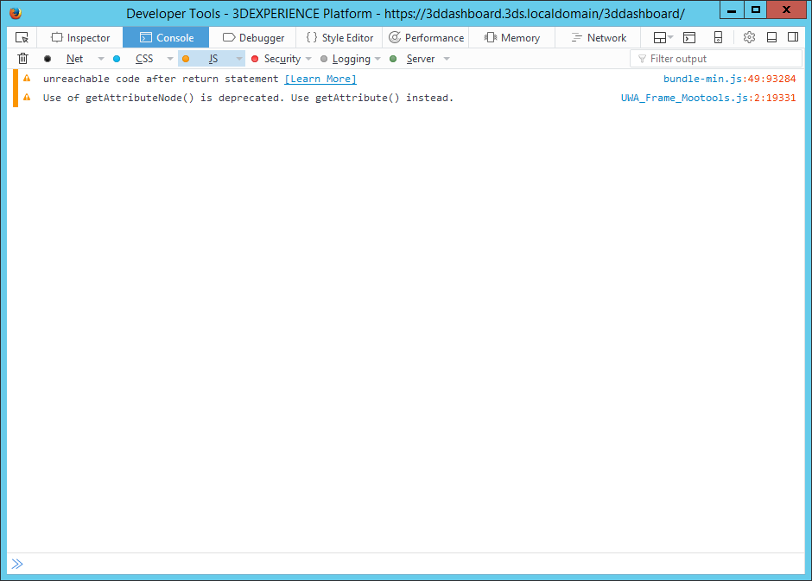
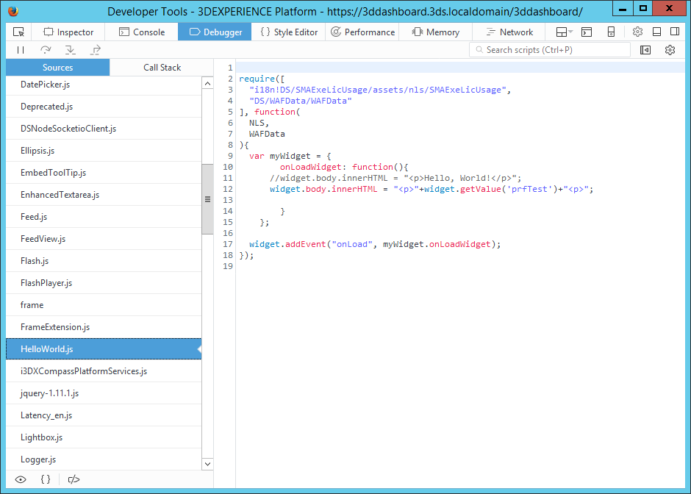
Tip : How to Debugging Widget?
Web Browser (F12 key) developer tool :

Slide 40
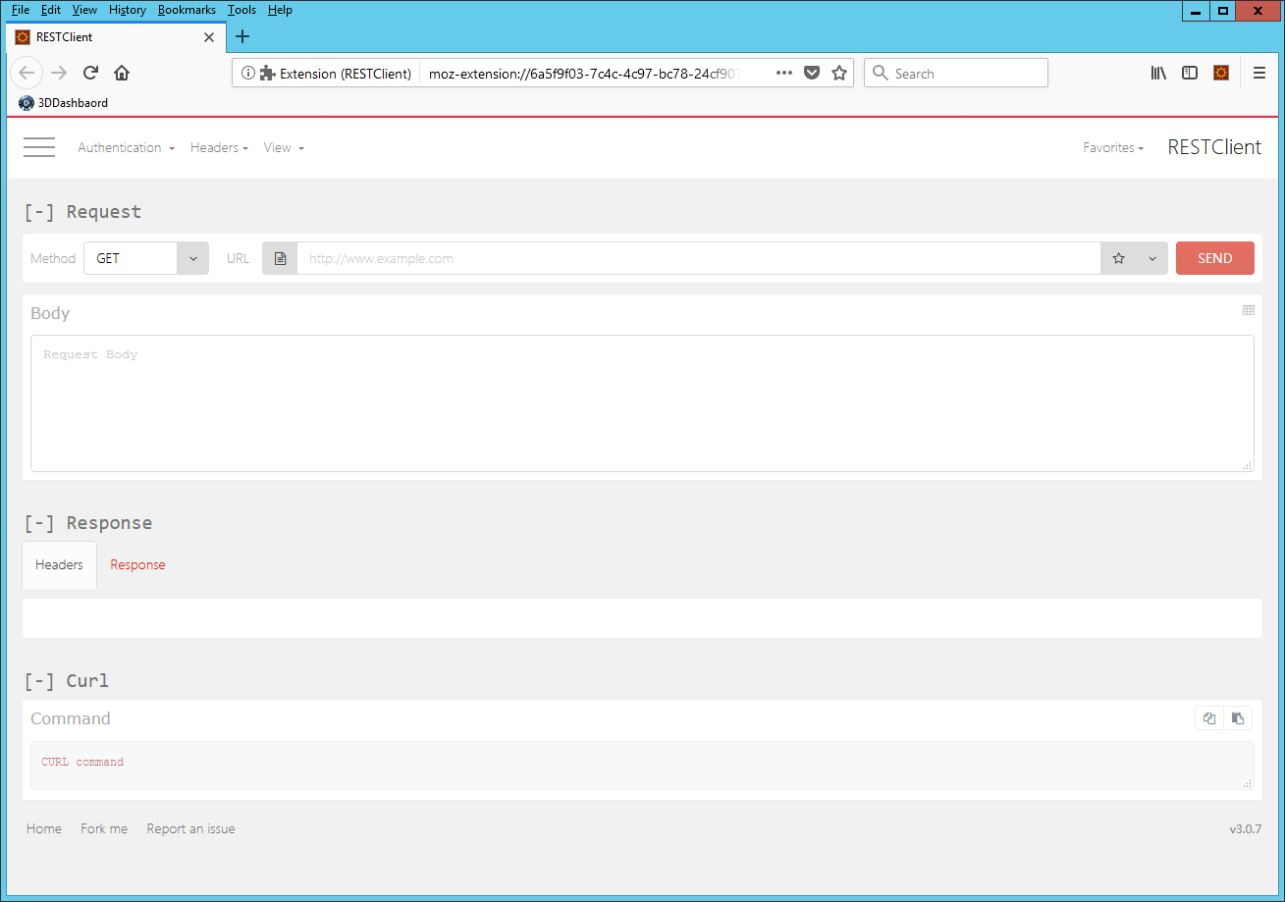
Tip : How to Debugging Widget?
Rest Client (Extension Program)

Slide 41
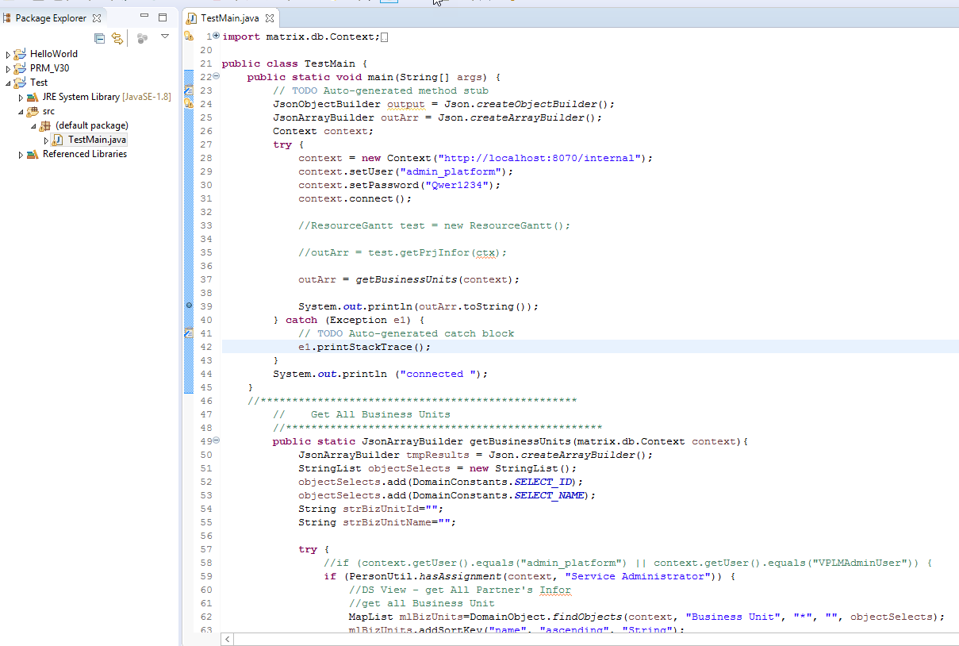
Tip : How to Debugging Widget?

Slide 42
Widget Reference

Slide 43
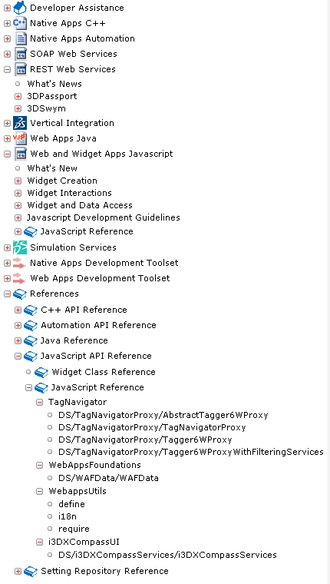
Where ?
#1
Source of
Information
Dsdoc:
In the CAA documentation :
http://dsdoc/devdoc/3DEXPERIENCER2018x/en/DSInternalDoc.htm (Internal View)
http://dsdoc/devdoccaa/3DEXPERIENCER2018x/en/DSDoc.htm (Customer View)
+ You have even more information in the 2019x doc

Slide 44
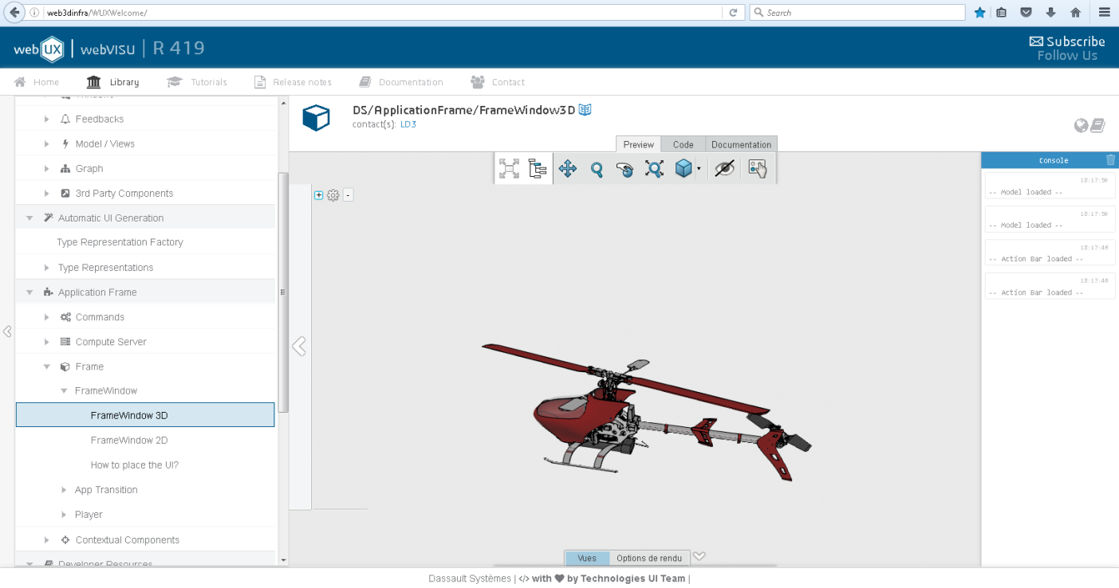
Where ?
Internal Use : Not exposed for customers
Web3DInfra components :
http://webux/r420/UIPortal/#r/420/

Slide 45
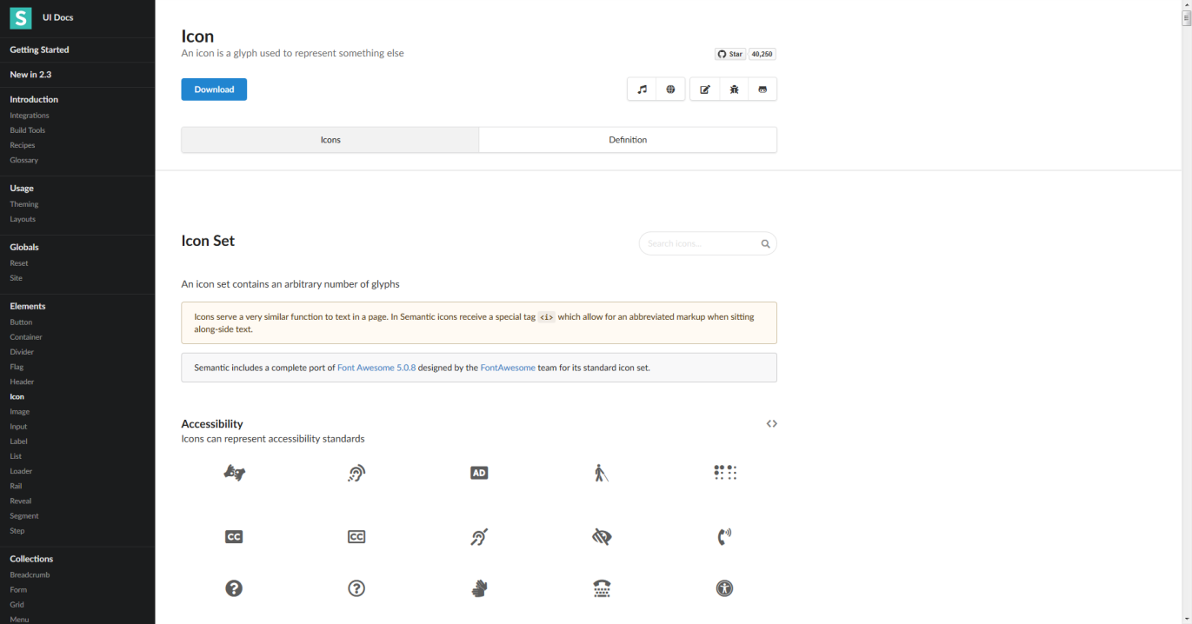
Where ?
Semantic UI
https://semantic-ui.com/elements/icon.html#user-actions
MIT license
A lot of UI Components
Not a DS Lib at all
Use it but no DS support
We use it in BT WW Team

Slide 46
Where ?
Swym :
Communities for Widgets developers :
3DS Widget Factory:
https://dsext001-eu1-215dsi0708-3dswym.3dexperience.3ds.com/#community:1208/blog
UWA Dev:
https://dsext001-eu1-215dsi0708-3dswym.3dexperience.3ds.com/#community:908/blog
3DExperience for developers: have a look at the wiki : getting started guide
https://dsext001-eu1-215dsi0708-3dswym.3dexperience.3ds.com/#community:740/blog
Posts of Mounir KEBLI (on WW Technical Sales Community):
REST WS example:
https://dsext001-eu1-215dsi0708-3dswym.3dexperience.3ds.com/#community:268/post:108293
TechExp June 2015 Widget Dev Introduction:
https://dsext001-eu1-215dsi0708-3dswym.3dexperience.3ds.com/#community:268/post:118775

Slide 47
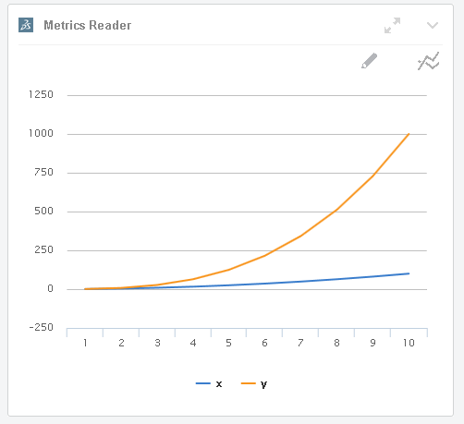

Where ?
Tutorials on the Web for HTML5, Javascript, CSS
Widget are developed using modules, to understand this design pattern, have a look at Require.js documentation:
http://requirejs.org/
Widgets are using the AMD design pattern (Asynchronous Module Definition)
You can use external JS Libraries but be careful with eventual the licensing
+ Not supported by DS
Jquery and Jquery UI are OK
Highchart requires licenses for commercial use
prefer using DS component instead (see W3DXComponents)
Contact the Legal Department for any question about licensing
Don’t forget to try the widget : Metrics Reader !

Slide 48
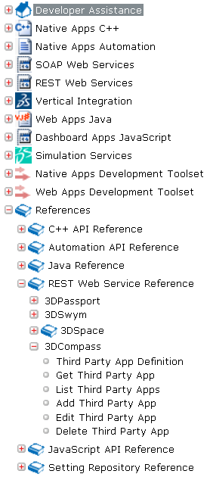
Automation of Add Third Party App
The 3DCompass Web Services are documented :
Use the “Add Third Party App” Web service to automate the addition of your Web Services via script
Use the “List Third Party App” Web service to retrieve the id of the Apps
Use the “Edit Third Party App” Web service to update the existing Apps
Script / small application need to be written
You will need to manage the Authentication through 3DPassport as admin before being able to contact the Web Service in your script

Slide 49


Slide 51
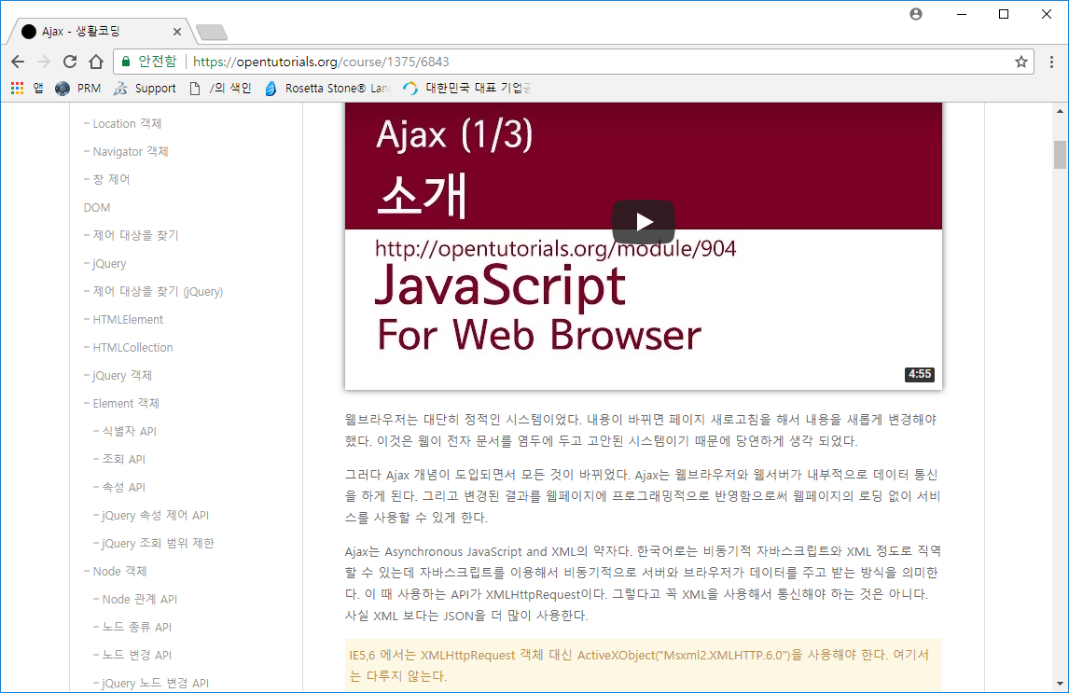
Ajax?
https://opentutorials.org/course/1375/6843

Slide 52
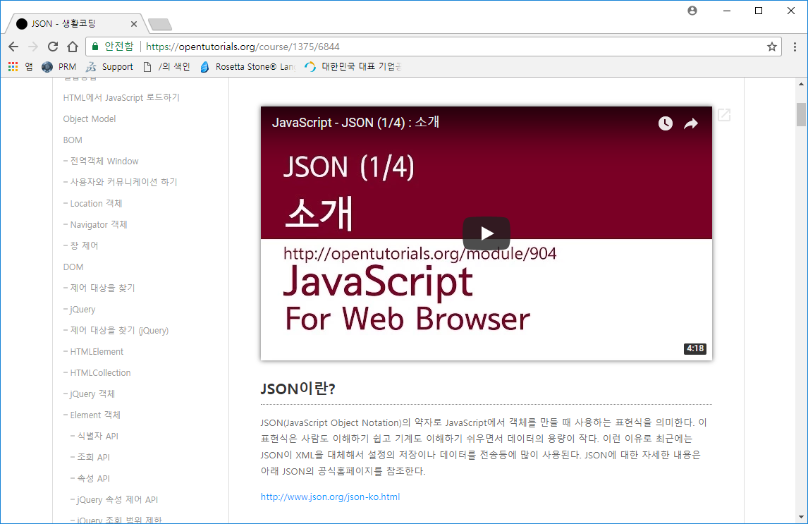
JSON?
https://opentutorials.org/course/1375/6844

Slide 53
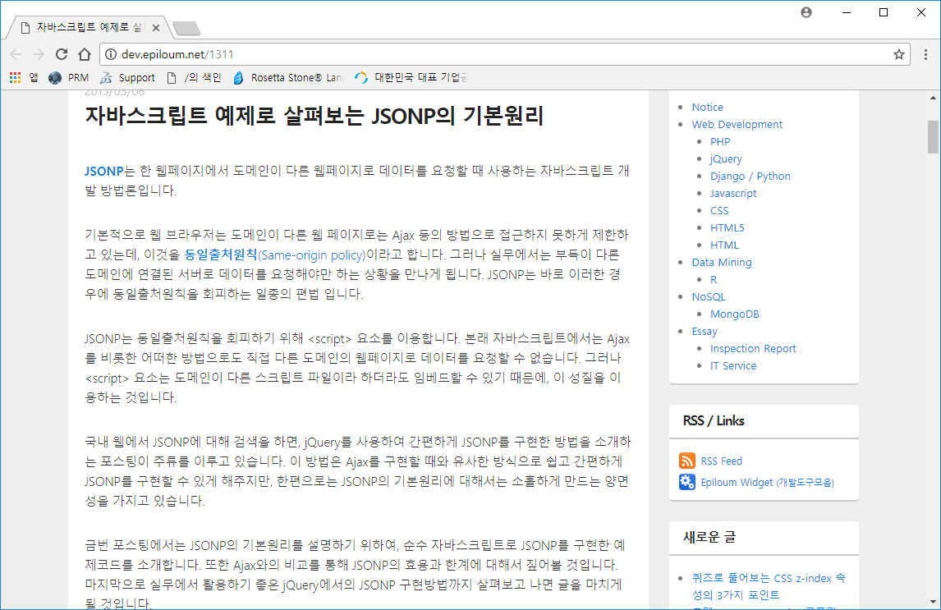
JSONP?
http://dev.epiloum.net/1311

